Slide 1

Predictive modelling for kickstarter projects
Aidan Soares – 012042436

Slide 2
About me
Student for Western Governors University’s Master of Data Analytics Program
Graduated with an undergraduate degree in Accounting and Financial Management in 2023

Slide 3
Research Problem
Using historical data, can a predictive model be constructed using logistic regression to determine the likelihood of a Kickstarter campaign's success?
Null Hypothesis, H₀: A predictive Logistic Regression model cannot be constructed from the research dataset with a model accuracy above 70%.
Alternative Hypothesis H₁: A predictive Logistic Regression model can be constructed from the research dataset with a model accuracy above 70%.

Slide 4
General summary of data analysis
What is the ideal goal?
Review of data distribution
Cleaning data
Paired t-test
Logistic regression model performance

Slide 5
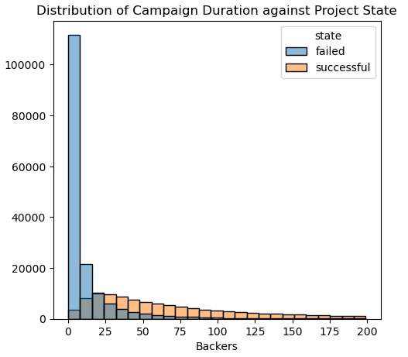
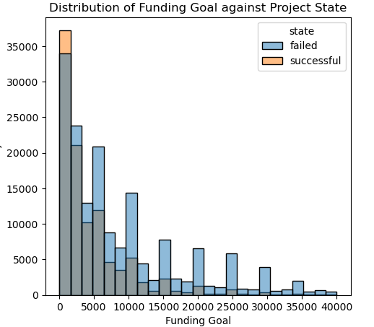
Exploratory analysis Data distribution
Backer count for failed and successful projects

Slide 6
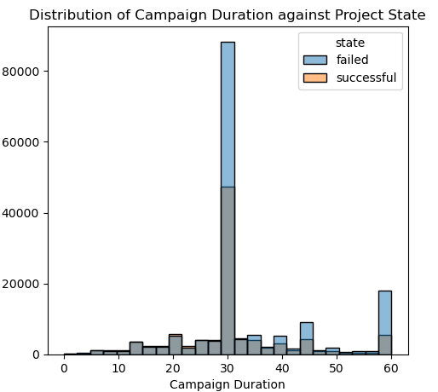
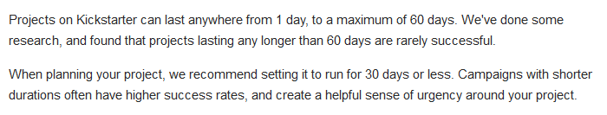
T-test
-- Kickstarter, 2024
A paired sample t-test compares the distribution of one group of data to another to identify important differences and trends between them.
Mathematical testing found that the two groups are statistically different.

Slide 7
Logistic regression
Utilizing existing data to train a machine learning model to make predictions

Slide 8
Outline of findings
Generalized outline of findings from logistic regression
Predictive accuracy of 90%
Projects that increased the chances of a campaign succeeding are Dance, Music, and Theater
Projects that decreased the chances of a campaign succeeding are Comics, Crafts, Design, Fashion, Film&Video, Food, Games, Journalism, Photography, Publishing, and Technology
The chances of meeting the funding goal strongly increase as the backer count increases
The chances of meeting the funding goal strongly decrease as the funding goal increases

Slide 9
Limitations of techniques used
Performance issues due to huge data values
Outdated dataset was used for analysis, model may not be perfectly suited for prediction in today’s environment

Slide 10
Proposed actions
Creators should utilize the predictive model to assess their project prior to launch, to identify if it needs tweaking during the planning phase
Creators should choose reasonable funding goals, setting a goal that aligns with costs. Creators should also take advantage of online marketing to promote their campaign, to attract support and garner backers

Slide 11
Expected benefits of study
Provides creators with a predictive model that can determine project’s likelihood of succeeding in current state
Indicates areas of focus for creators to target during their campaign (funding goal, backer count)
Saves creators time and resources

Slide 12
Sources
Kickstarter. (2024). Kickstarter Support; Getting Started. Kickstarter. Retrieved June 29, 2024, from https://help.kickstarter.com/hc/en-us/articles/115005128434-What-is-the-maximum-project-duration

